Slide 1
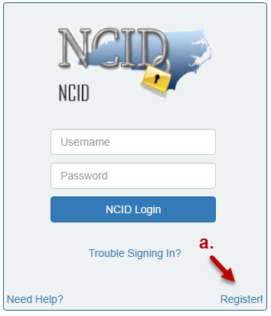
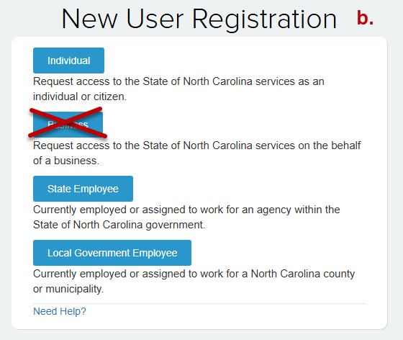
Enterprise Business Services (EBS) External Access Request Procedure
Create
only one NCID per individual.
Complete the following steps to request EBS access:
Register for an NCID Account: https://ncid.nc.gov
If you already have an NCID, continue with step 2
Click Register!
Select from the following categories, then proceed as directed.
  Individual
  State Employee
  Local Government Employee
NCIDs must be for a specific individual.
Do not select Business.
Enter your First, Middle and Last name and your Email address.
Do not create an account on behalf of someone else.
Shared business or organization NCIDs will not be accepted for EBS use.
NCIDs can be linked to multiple businesses/organizations in EBS. Do not create a new NCID for each grant program or organization supported. Use the same NCID for all EBS Access Requests.

Slide 2
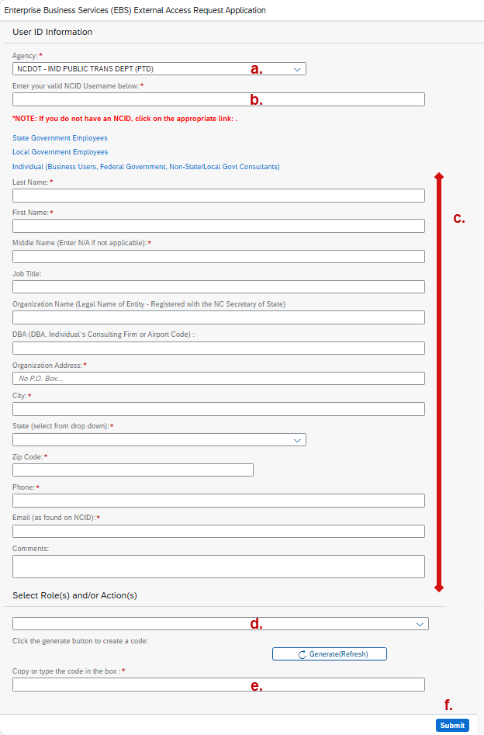
Enterprise Business Services (EBS) External Access Request Procedure
Complete an EBS External Access Request Form:
https://www.ebs.nc.gov/sap/crmaccess/index.html
Select Agency from the dropdown.
Enter NCID Username.
Complete User Information:
  Name as found on the NCID
  Organizational information and address
  Individual’s Phone and Email as found on the NCID
Select Role.
Click Generate(Refresh) to get a code. Enter the code into box e.
Click Submit and write down the confirmation number.
Your NCID, name and email
must match the NCID exactly!
The fields in this section differ based on the Agency selected.
Your request will be rejected if:
Your NCID does not exist.
Your First, Middle, Last Name or Email does not match your NCID exactly.
You already have an active EBS Account under a different NCID. Use your original NCID on the EBS Access Request.

Slide 3
Enterprise Business Services (EBS) External Access Request Procedure
On average, EBS Access Requests take 3-5 business days to process.
For the status of your Access Request, contact the EBS Grant Security Coordinator:
fmccullen@ncdot.gov
  Include the following information in your email:
  Name
  Phone number
  EBS Access Request Confirmation Number (Refer to page 2, step f.)
You will receive an EBS Welcome letter when your account is ready to use.
  Follow the First-Time logon instructions exactly as they are written.
  If you are unable to logon, contact EBS Support at EBSSupport@ncdot.gov.
  Government users who access EBS via NCID, should change their password every 90 days: https://ncid.nc.gov
  Non-Government users who access EBS via myNCID, MUST change their myNCID password every 90 days: https://myNCID.nc.gov
  Please note, Government and Non-Government users use different NCID websites to change passwords.

